Slide 1


Mid-career professionals are seeking new at-home experiences
PROFILE
MOST USED SOCIAL MEDIA
COVID-19 IMPACT
Age: 30 years
Location: Philadelphia
Experiment new brands
Gender: Female
Job: Consultant
More than 75% of consumers have experimented with a different shopping behavior during the crisis, including trying new brands. (Source: McKinsey)
WHAT THEY’RE LOOKING FOR
Instagrammable
Ethical Sourcing
Rise of at-home travel
“I need new experiences that lets me see the bigger world, take new photos for my feed, and meet my friends for a nice meal.”
Consumers are looking for ways to engage in travel-like experiences. Airbnb launched online experiences and famous landmarks now have virtual tours available.
Personalized Service
Exclusivity
PURCHASE BEHAVIOR
Desire for social interactions
$80
Search interest in “watching together” is up over 4X since early January. Consumers are seeking for new activities to do with their respective families (Source: Google)
$40
$20

Slide 2
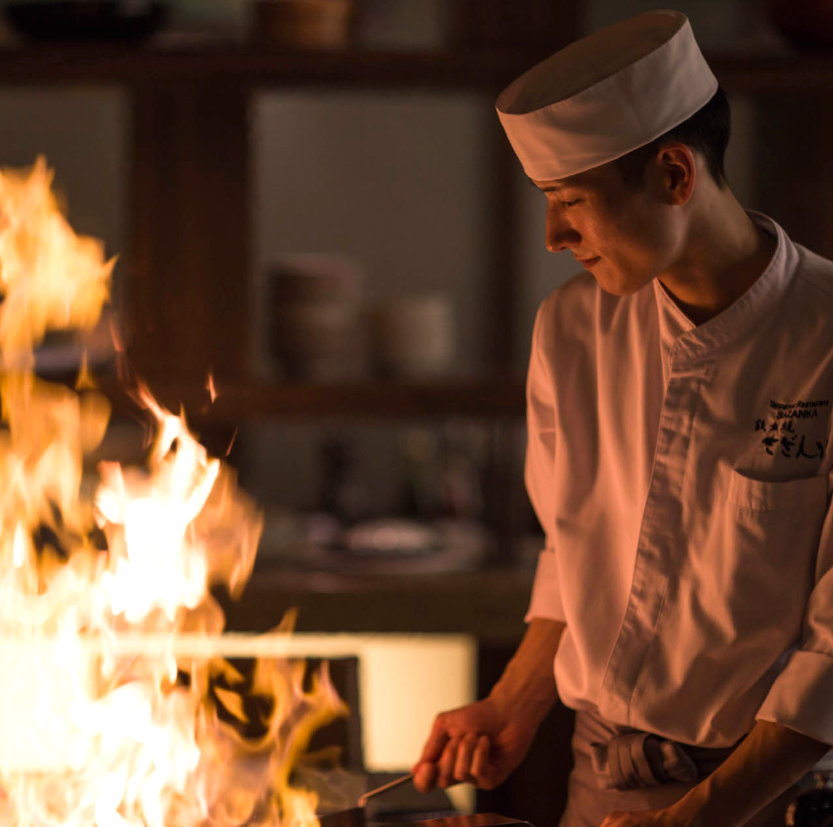
Omakase brings Japan to your home
Impact
250
Profit per omakase
10+
Quality
Care
Experience
Jobs retained
With the freshest and most exclusive ingredients using bincho-zumi, a smokeless charcoal, we can bring the authentic teppanyaki experience to your home.
Our chefs are professionally trained in Japanese history, cuisine, and etiquette. We provide full-service from equipment, ingredients, to cleaning
Celebrate your special occasions at home. Gather around expert teppanyaki chefs are they prepare dishes with flair and precision right before your eyes.
26,000
Monthly profit
Projected financials for year 1 in appendix
Notes:
this is a new venture
Even after covid stops, we have sourcing from japan (we can explore either continue this service or move in store for premium)

